Slide 1



SRI KRISHNA COLLEGE OF ENGINEERING AND TECHNOLOGY
Kuniamuthur, Coimbatore, Tamilnadu, India
An Autonomous Institution, Affiliated to Anna University,
Accredited by NAAC with “A” Grade & Accredited by NBA (CSE, ECE, IT, MECH ,EEE, CIVIL& MCT)
Topic : Stack
www.skcet.ac.in

Slide 2
Stack Data Structure
Stack is an abstract data type with a bounded(predefined) capacity.
It is a simple data structure that allows adding and removing elements in a particular order.
Every time an element is added, it goes on the top of the stack and the only element that can be removed is the element that is at the top of the stack, just like a pile of objects.

Slide 3
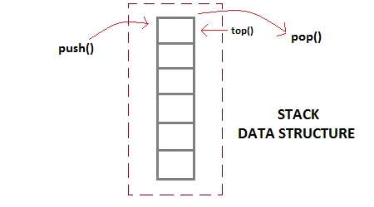

Slide 4
Basic features of Stack
Stack is an ordered list of similar data type.
Stack is a LIFO(Last in First out) structure or we can say FILO(First in Last out).
push() function is used to insert new elements into the Stack and pop() function is used to remove an element from the stack. Both insertion and removal are allowed at only one end of Stack called Top.
Stack is said to be in Overflow state when it is completely full and is said to be in Underflow state if it is completely empty.

Slide 5
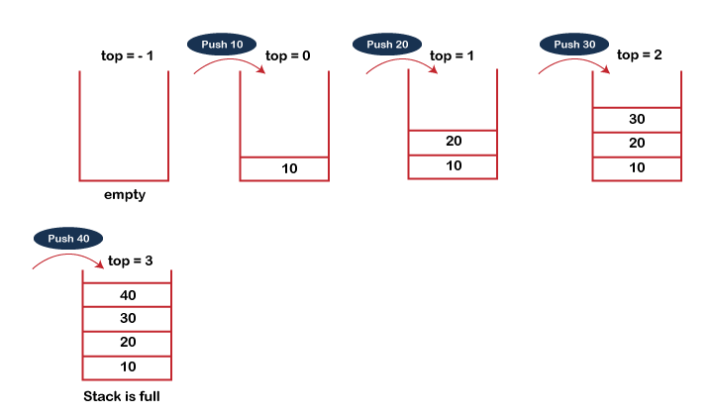
Example
PUSH operation

Slide 6
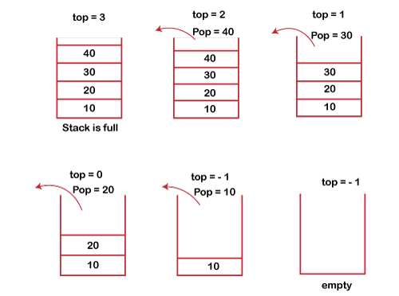
POP operation

Slide 7
Position of Top | Status of Stack
-1 | Stack is Empty
0 | Only one element in Stack
N-1 | Stack is Full
N | Overflow state of Stack

Slide 8
Applications of Stack
Balancing of symbols
String reversal
UNDO/REDO
Recursion
Expression conversion

Slide 9
Array implementation of Stack
Adding an element onto the stack (push operation)
Adding an element into the top of the stack is referred to as push operation. Push operation involves following two steps.
Increment the variable Top so that it can now refere to the next memory location.
Add element at the position of incremented top. This is referred to as adding new element at the top of the stack.

Slide 10
Algorithm:
begin
if top = n then stack full
top = top + 1
stack (top) : = item;
end

Slide 11
Array implementation of Stack using C
void push (int val,int n) //n is size of the stack
{
if (top == n )
printf("\n Overflow");
else
{
top = top +1;
stack[top] = val;
} }

Slide 12
Deletion of an element from a stack (Pop operation)
Deletion of an element from the top of the stack is called pop operation.
The value of the variable top will be incremented by 1 whenever an item is deleted from the stack.
The top most element of the stack is stored in an another variable and then the top is decremented by 1. the operation returns the deleted value that was stored in another variable as the result.

Slide 13
Algorithm :
begin
if top = 0 then stack empty;
item := stack(top);
top = top - 1;
end;

Slide 14
Array implementation of Stack using C
int pop ()
{
if(top == -1)
{
printf("Underflow");
return 0;
}
else
{
return stack[top - - ];
}
}

Slide 15
Visiting each element of the stack (Peek operation)
Peek operation involves returning the element which is present at the top of the stack without deleting it. Underflow condition can occur if we try to return the top element in an already empty stack.
Begin
if top = -1 then stack empty
item = stack[top]
return item
End

Slide 16
Implementation of Peek algorithm in C language
int peek()
{
if (top == -1)
{
printf("Underflow");
return 0;
}
else
{
return stack [top];
}
}

